Slide 1


Consequences of parasite evolution on host populations
MAGPIE Seminar, Simon Fraser University
18th October 2022
Alistair Pirrie, Cameron Smith, Jason Wood

Slide 2




(A subset of) the eco-evo theory group
Ben Ashby – Associate Professor
Alistair Pirrie – PhD student arp59@bath.ac.uk
Cameron Smith– Postdoc cs640@bath.ac.uk
Jason Wood– PhD Student jrw78@bath.ac.uk

Slide 3
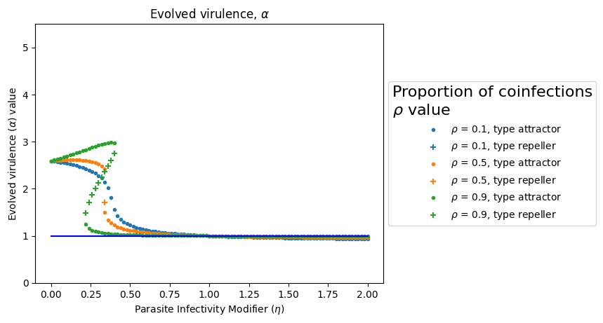
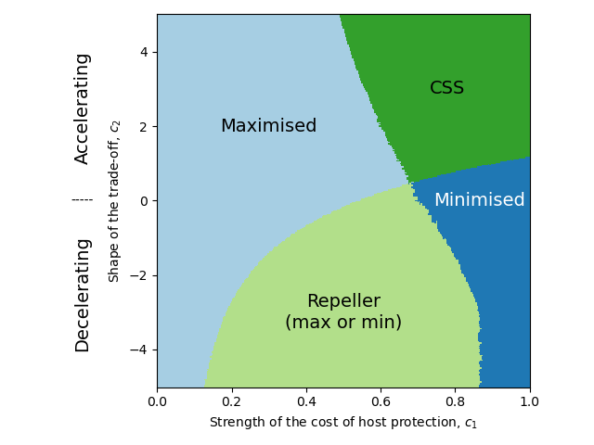
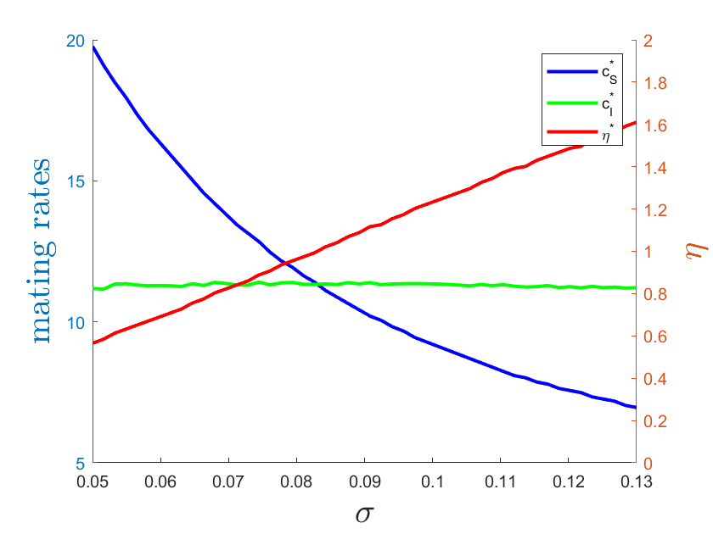
Outline
Introduction to adaptive dynamics, the next generation method and simulation techniques.
Evolutionary consequences of hyperparasite introduction.
Coevolution of a defensive symbiont and parasite, and the effect on the host population.
Coevolution of host mating rate and manipulation by a sexually transmitted infection (STI).

Slide 4
Introduction

Slide 5
Justifications
We assume direct links between certain biological parameters
These links can be justified mechanistically
Or experimentally studied and justified
We consider evolution to occur through standard mutations, e.g. errors in replication of genes
We assume these mutations occur at a much slower timescale relative to the ecological or epidemiological dynamics we wish to study

Slide 6
Fitness
We can define fitness approximately as a measure of the average number of new individuals produced by a member of a specific class over the members entire lifespan
Then by assuming there is interclass competition, the species with the higher fitness will replace the lower fitness individuals
Through the adaptive dynamics assumptions just discussed, namely separation of timescales and links between parameters, we can begin to investigate evolutionary questions

Slide 7
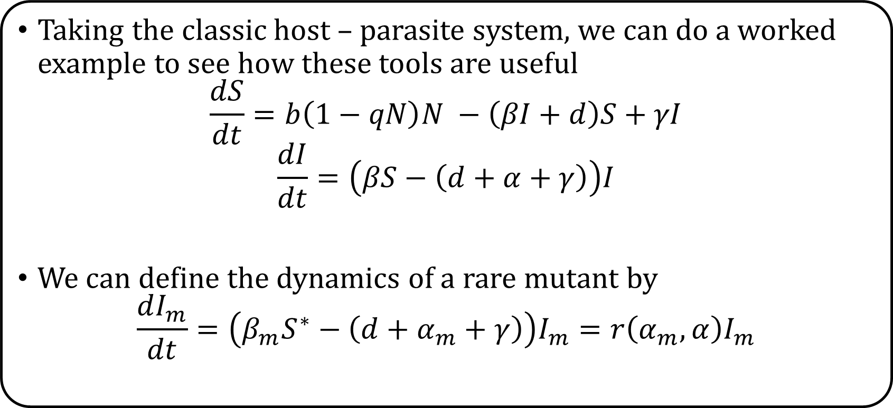
Toy Example
Taking the classic host – parasite system, we can do a worked example to see how these tools are useful
$$\frac{dS}{dt}=b\left(1−qN\right)N −\left(βI+d\right)S+γI$$
$$\frac{dI}{dt}=\left(βS−\left(d+α+γ\right)\right)I$$
We can define the dynamics of a rare mutant by
$$\frac{dI_{m}}{dt}=\left(β_{m}S^{∗}−\left(d+α_{m}+γ\right)\right)I_{m}=r\left(α_{m}, α\right)I_{m}$$

Slide 8
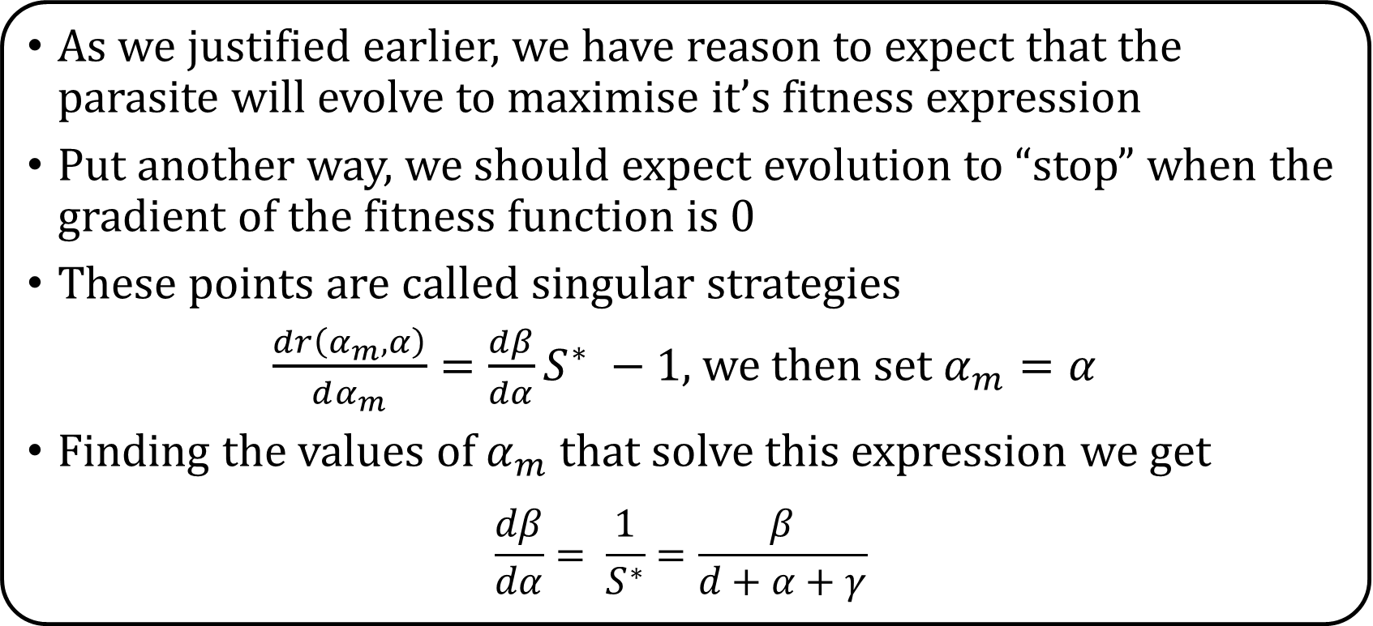
Toy Example
As we justified earlier, we have reason to expect that the parasite will evolve to maximise it’s fitness expression
Put another way, we should expect evolution to “stop” when the gradient of the fitness function is 0
These points are called singular strategies
we then set $α_{m}=α$
Finding the values of $α_{m}$ that solve this expression we get
$$\frac{dβ}{dα}= \frac{1}{S^{∗}}=\frac{β}{d+α+γ}$$

Slide 9
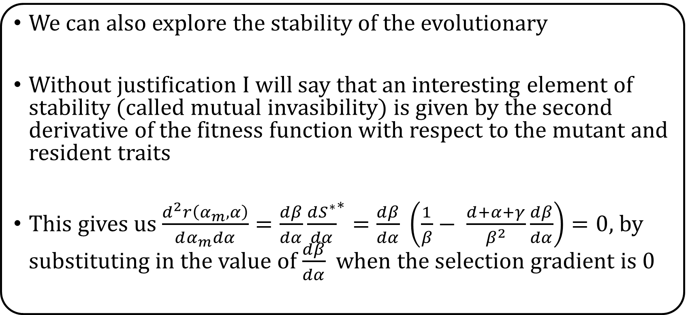
Toy Example
We can also explore the stability of the evolutionary
Without justification I will say that an interesting element of stability (called mutual invasibility) is given by the second derivative of the fitness function with respect to the mutant and resident traits
This gives us $\frac{d^{2}r\left(α_{m}, α\right)}{dα_{m}dα}=\frac{dβ}{dα}{\frac{dS^{∗}}{dα}}^{∗}=\frac{dβ}{dα} \left(\frac{1}{β}− \frac{d+α+γ}{β^{2}}\frac{dβ}{dα}\right)=0$, by substituting in the value of $\frac{dβ}{dα}$ when the selection gradient is 0

Slide 10
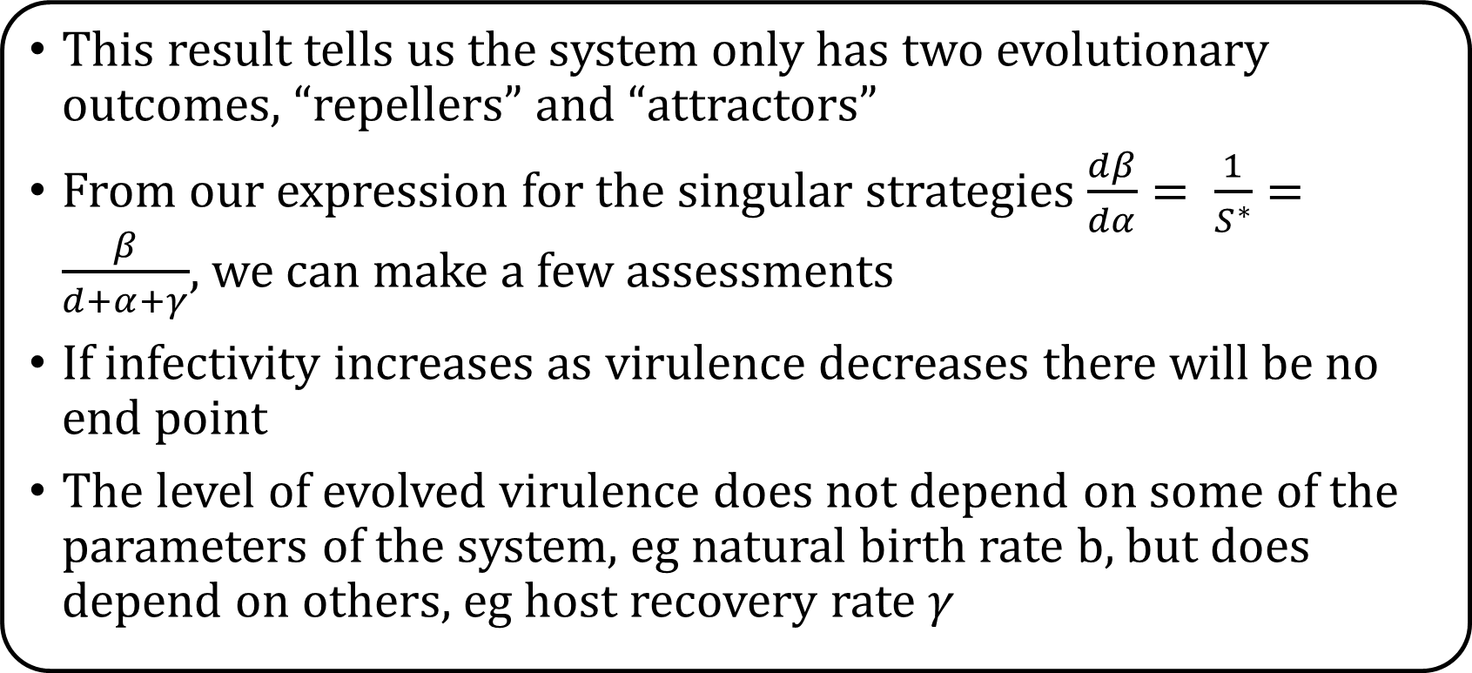
Toy Example
This result tells us the system only has two evolutionary outcomes, “repellers” and “attractors”
From our expression for the singular strategies $\frac{dβ}{dα}= \frac{1}{S^{∗}}=\frac{β}{d+α+γ}$, we can make a few assessments
If infectivity increases as virulence decreases there will be no end point
The level of evolved virulence does not depend on some of the parameters of the system, eg natural birth rate b, but does depend on others, eg host recovery rate $γ$

Slide 11
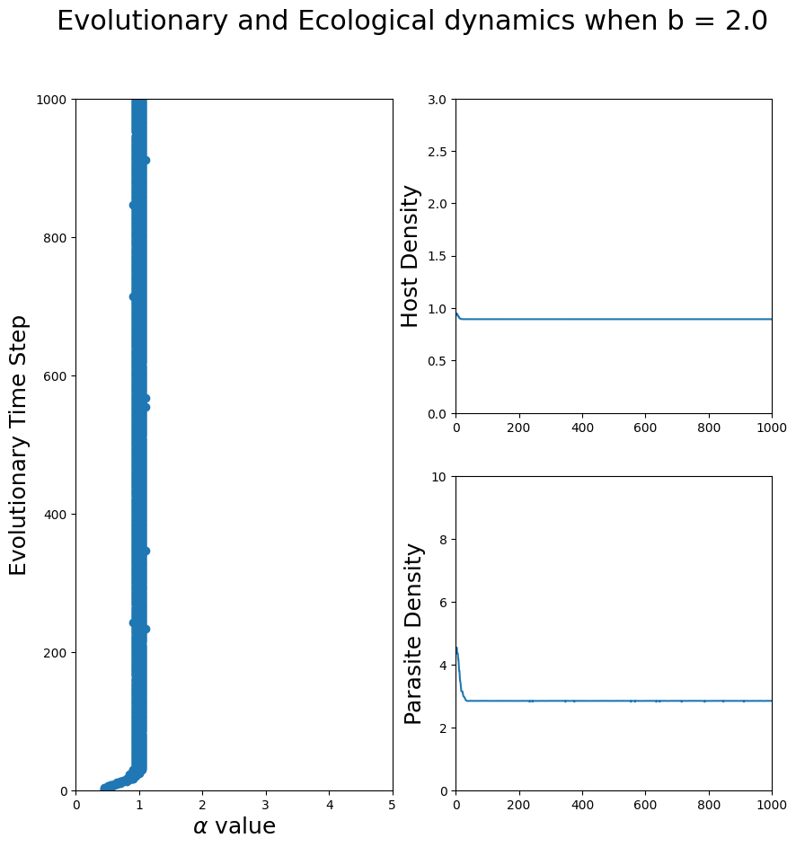
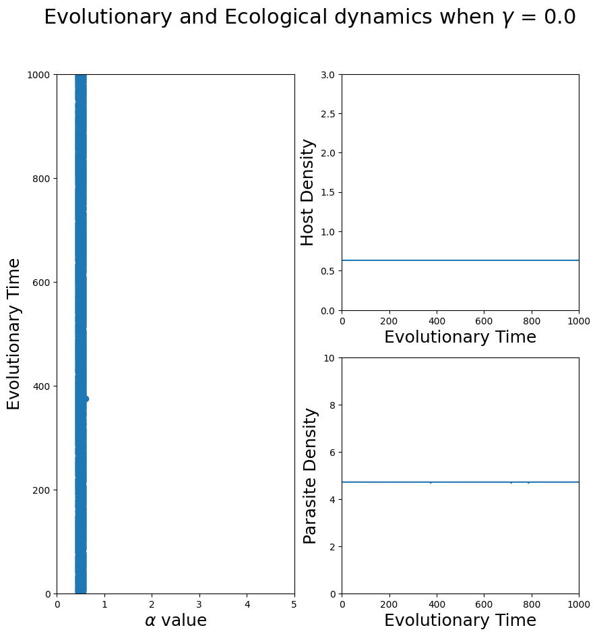
Toy Example

Slide 12
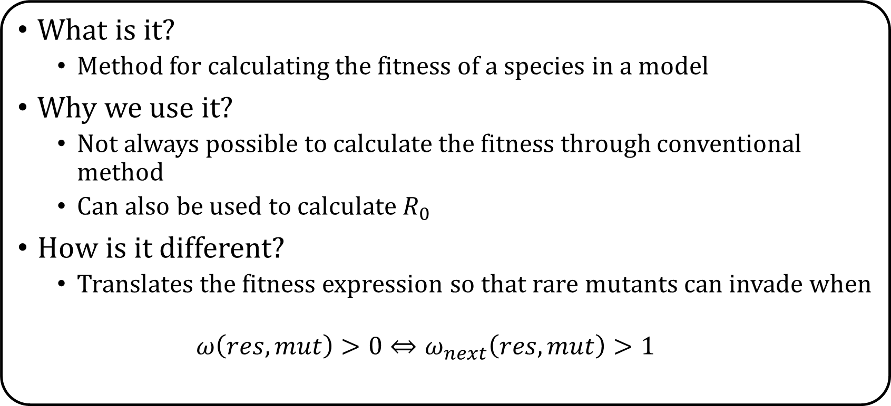
The next-generation method
What is it?
Method for calculating the fitness of a species in a model
Why we use it?
Not always possible to calculate the fitness through conventional method
Can also be used to calculate $R_{0}$
How is it different?
Translates the fitness expression so that rare mutants can invade when
$$ω\left(res,mut\right)>0⇔ω_{next}\left(res,mut\right)>1$$

Slide 13
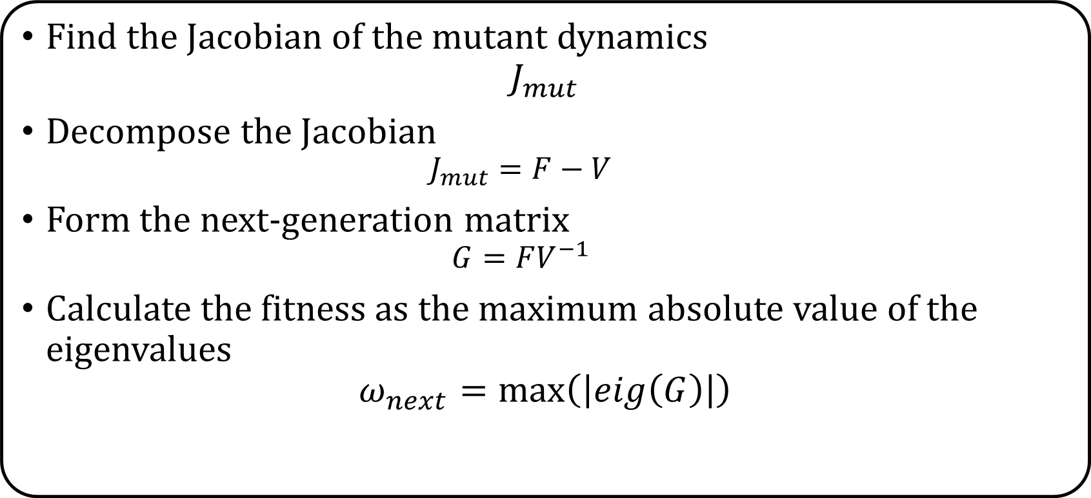
How to use the method
Find the Jacobian of the mutant dynamics
$$J_{mut}$$
Decompose the Jacobian
$$J_{mut}=F−V$$
Form the next-generation matrix
$$G=FV^{−1}$$
Calculate the fitness as the maximum absolute value of the eigenvalues
$$ω_{next}=max⁡\left(\left|eig\left(G\right)\right|\right)$$

Slide 14
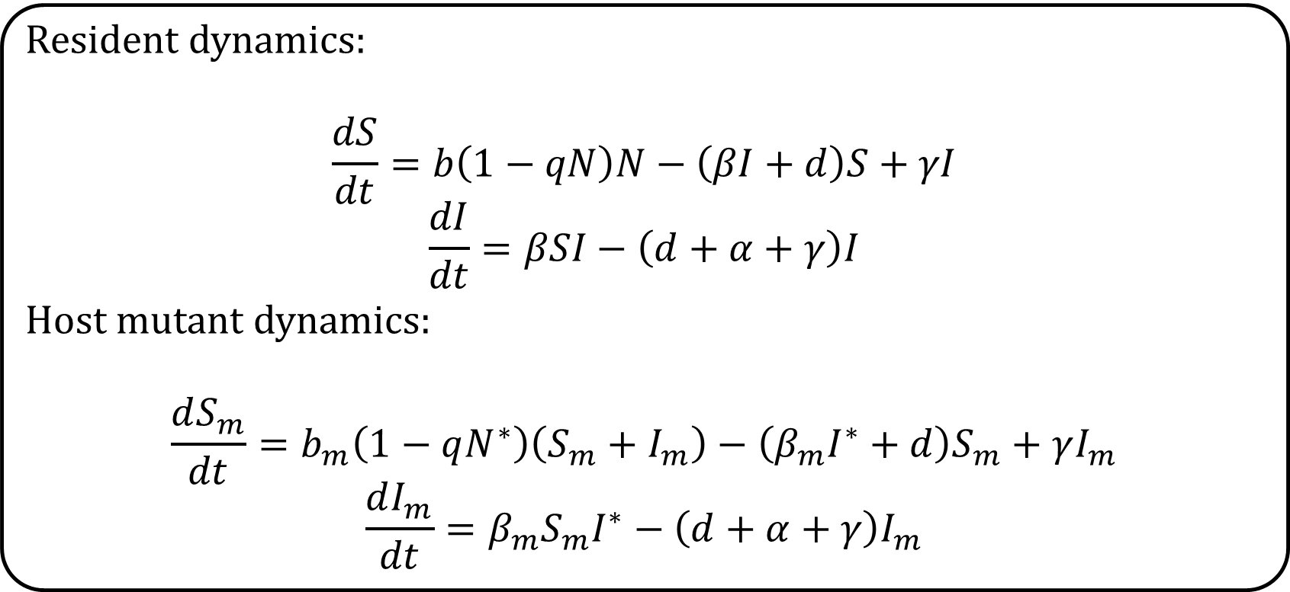
Example
Resident dynamics:
$$\frac{dS}{dt}=b\left(1−qN\right)N−\left(βI+d\right)S+γI$$
$$\frac{dI}{dt}=βSI−\left(d+α+γ\right)I$$
Host mutant dynamics:
$$\frac{dS_{m}}{dt}=b_{m}\left(1−qN^{∗}\right)\left(S_{m}+I_{m}\right)−\left(β_{m}I^{∗}+d\right)S_{m}+γI_{m}$$
$$\frac{dI_{m}}{dt}=β_{m}S_{m}I^{∗}−\left(d+α+γ\right)I_{m}$$

Slide 15
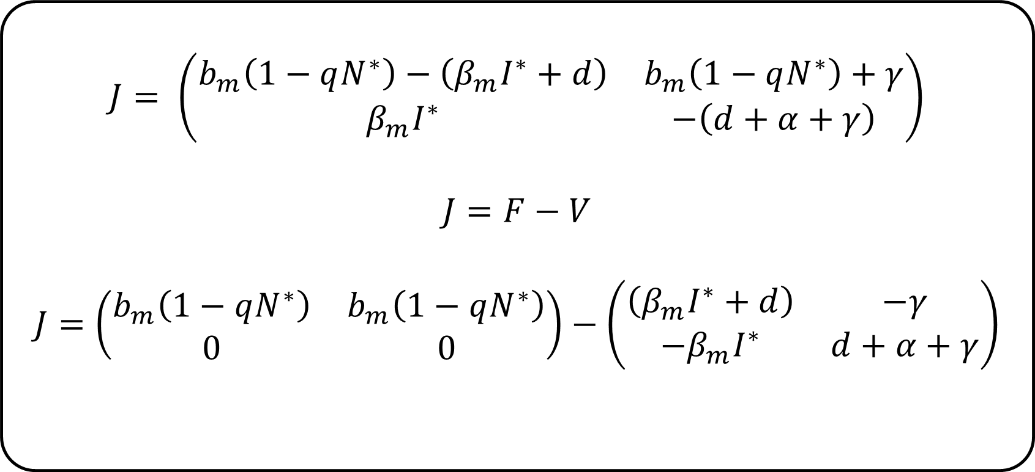
Example
$$J= \left(\begin{matrix}b_{m}\left(1−qN^{∗}\right)−\left(β_{m}I^{∗}+d\right) & b_{m}\left(1−qN^{∗}\right)+γ \\ β_{m}I^{∗} & −\left(d+α+γ\right)\end{matrix}\right)$$
$$J=F−V$$
$$J=\left(\begin{matrix}b_{m}\left(1−qN^{∗}\right) & b_{m}\left(1−qN^{∗}\right) \\ 0 & 0\end{matrix}\right)−\left(\begin{matrix}\left(β_{m}I^{∗}+d\right) & −γ \\ −β_{m}I^{∗} & d+α+γ\end{matrix}\right)$$

Slide 16
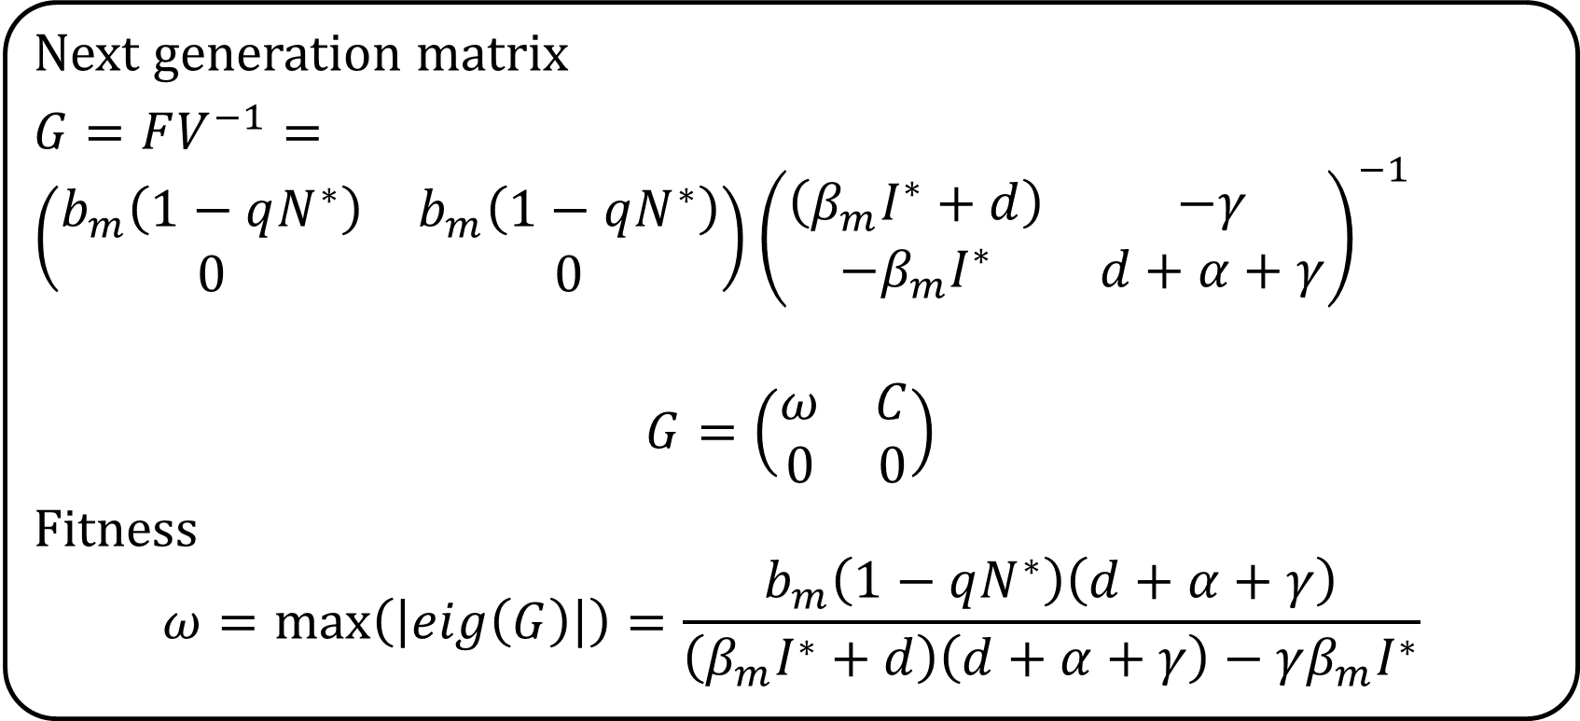
Example
Next generation matrix
$G=FV^{−1}=$ $\left(\begin{matrix}b_{m}\left(1−qN^{∗}\right) & b_{m}\left(1−qN^{∗}\right) \\ 0 & 0\end{matrix}\right){\left(\begin{matrix}\left(β_{m}I^{∗}+d\right) & −γ \\ −β_{m}I^{∗} & d+α+γ\end{matrix}\right)}^{−1}$
$$G=\left(\begin{matrix}ω & C \\ 0 & 0\end{matrix}\right)$$
Fitness
$$ω=\max\left(\left|eig\left(G\right)\right|\right)=\frac{b_{m}\left(1−qN^{∗}\right)\left(d+α+γ\right)}{\left(β_{m}I^{∗}+d\right)\left(d+α+γ\right)−γβ_{m}I^{∗}}$$

Slide 17
Simulation techniques

Slide 18
Evolutionary consequences of hyperparasite introduction

Slide 19
Why care about hyperparasites
There have been a large number of experimental studies investigating parasite – hyperparasite interactions
Little theoretical or experimental work has been done in more natural environments
Hyperparasites have also been used as forms of biocontrol
Additionally bacteriophages are a potential tool against AMR diseases
As parasites can adapt to hyperparasites in any of these settings, questions regarding how this affects the long term efficacy of these strategies must be answered

Slide 20
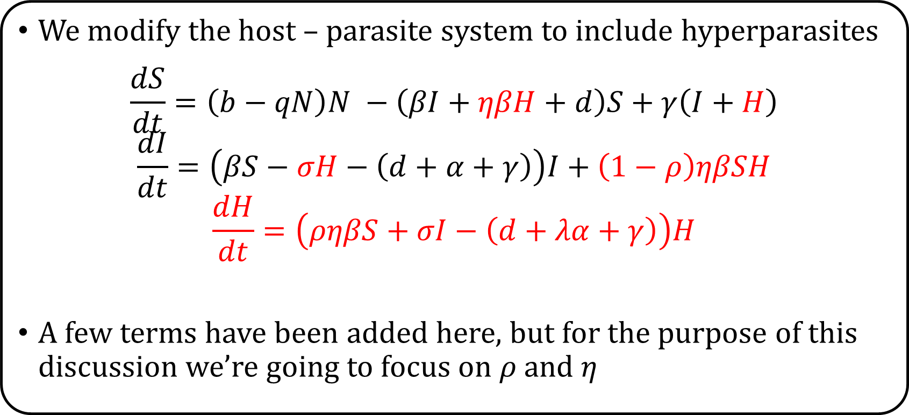
The ecological dynamics
We modify the host – parasite system to include hyperparasites
$$\frac{dS}{dt}=\left(b−qN\right)N −\left(βI+ηβH+d\right)S+γ\left(I+H\right)$$
$$\frac{dI}{dt}=\left(βS−σH−\left(d+α+γ\right)\right)I+\left(1−ρ\right)ηβSH$$
$$\frac{dH}{dt}=\left(ρηβS+σI−\left(d+λα+γ\right)\right)H$$
A few terms have been added here, but for the purpose of this discussion we’re going to focus on $ρ$and $η$

Slide 21
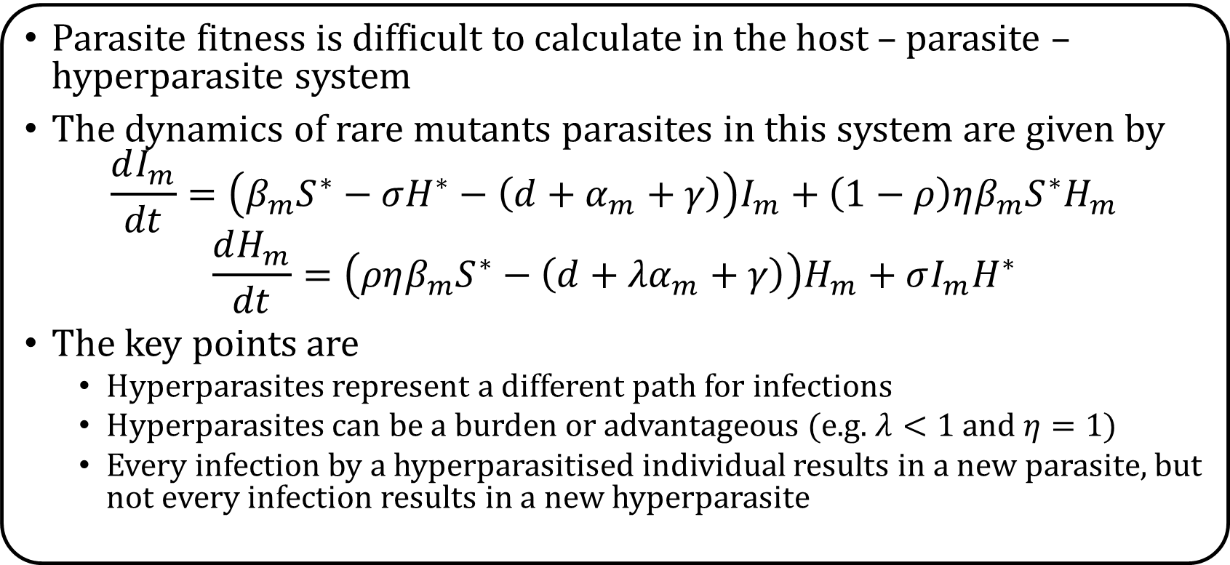
Hyperparasites and fitness
Parasite fitness is difficult to calculate in the host – parasite – hyperparasite system
The dynamics of rare mutants parasites in this system are given by
$$\frac{dI_{m}}{dt}=\left(β_{m}S^{∗}−σH^{∗}−\left(d+α_{m}+γ\right)\right)I_{m}+\left(1−ρ\right)ηβ_{m}S^{∗}H_{m}$$
$$\frac{dH_{m}}{dt}=\left(ρηβ_{m}S^{∗}−\left(d+{λα}_{m}+γ\right)\right)H_{m}+σI_{m}H^{∗}$$
The key points are
Hyperparasites represent a different path for infections
Hyperparasites can be a burden or advantageous (e.g. $λ<1$ and $η=1$)
Every infection by a hyperparasitised individual results in a new parasite, but not every infection results in a new hyperparasite

Slide 22
Changes to Singular strategy location

Slide 23
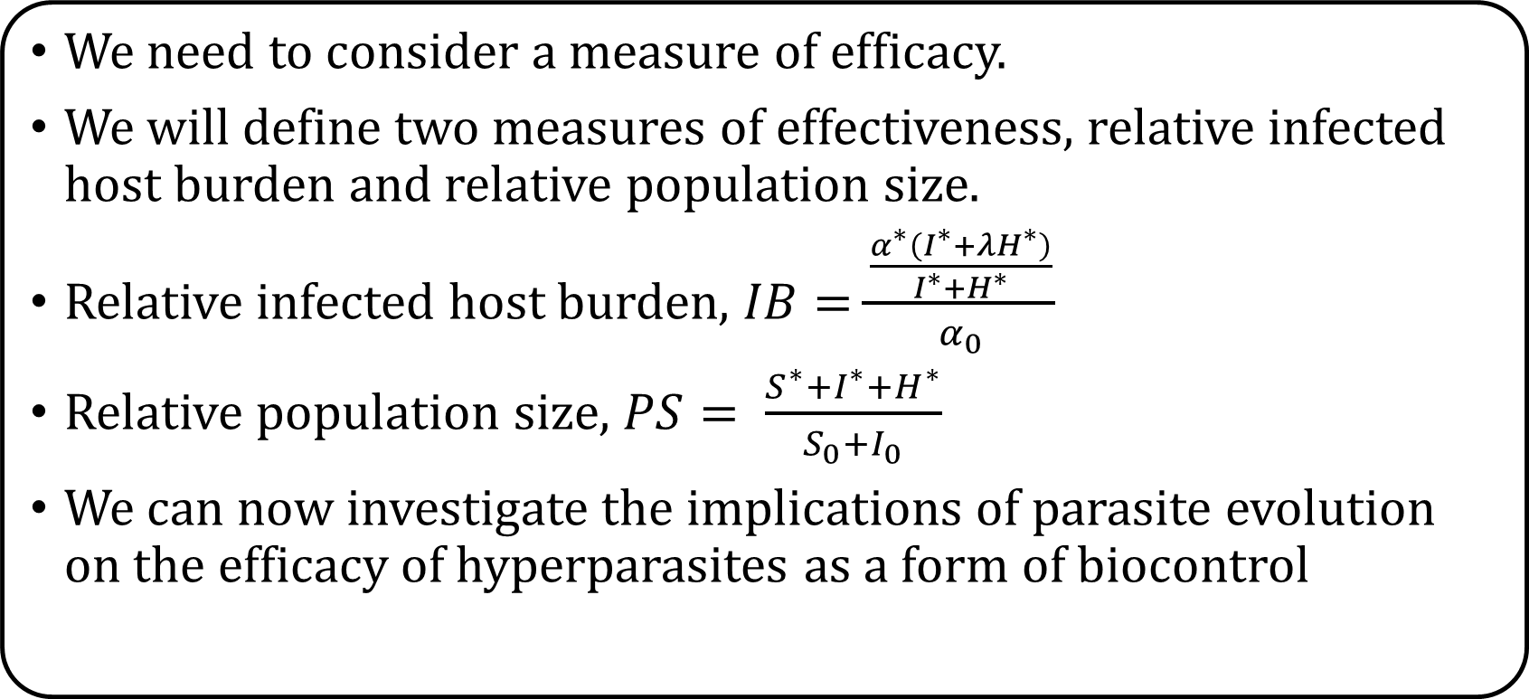
Implications for Biocontrol
We need to consider a measure of efficacy.
We will define two measures of effectiveness, relative infected host burden and relative population size.
Relative infected host burden, $IB=\frac{\frac{α^{∗}\left(I^{∗}+λH^{∗}\right)}{I^{∗}+H^{∗}}}{α_{0}}$
Relative population size, $PS= \frac{S^{∗}+I^{∗}+H^{∗}}{S_{0}+I_{0}}$
We can now investigate the implications of parasite evolution on the efficacy of hyperparasites as a form of biocontrol

Slide 24
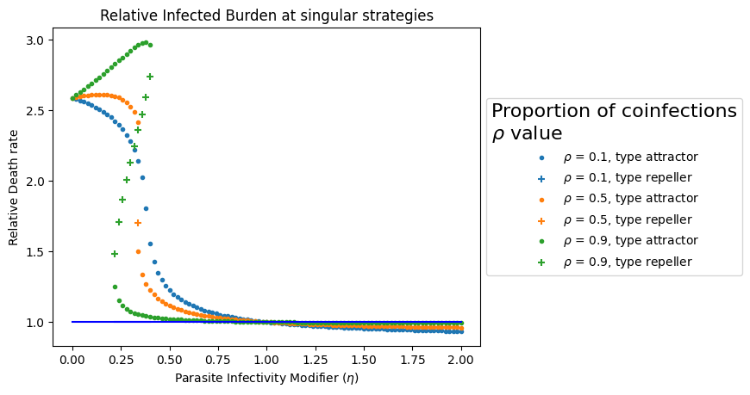
Affected on Infected Host Burden

Slide 25
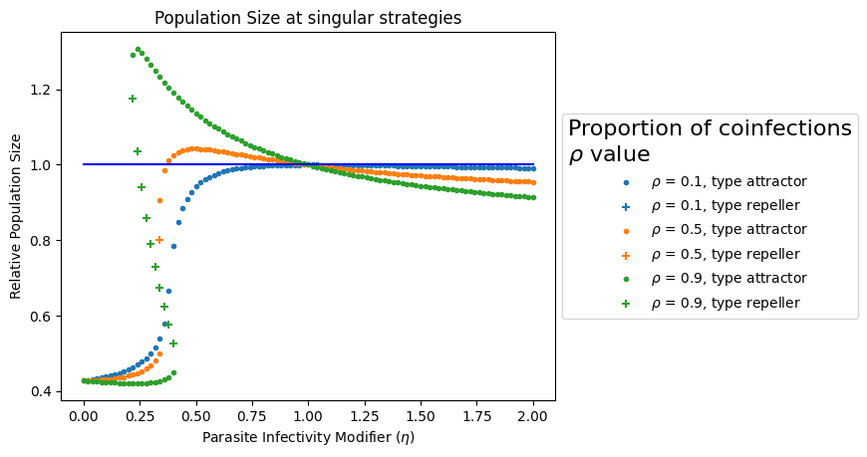
Affect on Population Size

Slide 26
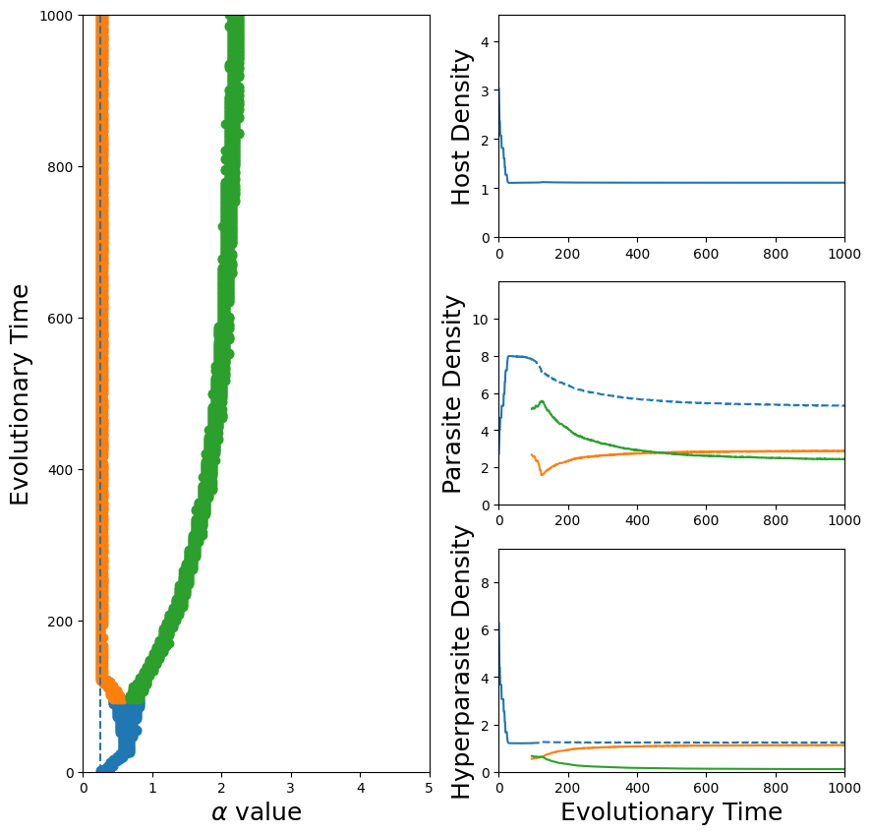
Diversification

Slide 27
Conclusion
Investigate the evolutionary consequences of introducing a hyperparasite population to evolvable parasites
Parasite evolution of virulence when a novel hyperparasite is introduced
The introduction of hyperparasites can be beneficial or detrimental over an evolutionary timescale. Hyperparasites also create conditions for diversification

Slide 28
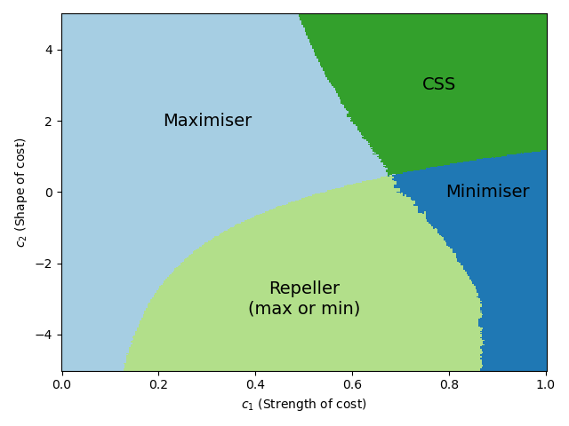
Defensive Symbiont Coevolution

Slide 29
What and why?
AIM:
To establish the long-term effects of the introduction of a defensive mutualist on a population of hosts infected by a parasite.
WHY?
Defensive symbionts are potential candidates for biocontrol agents.
Previous theory suggests defensive symbionts evolve along the mutualistic-parasitic continuum.

Slide 30


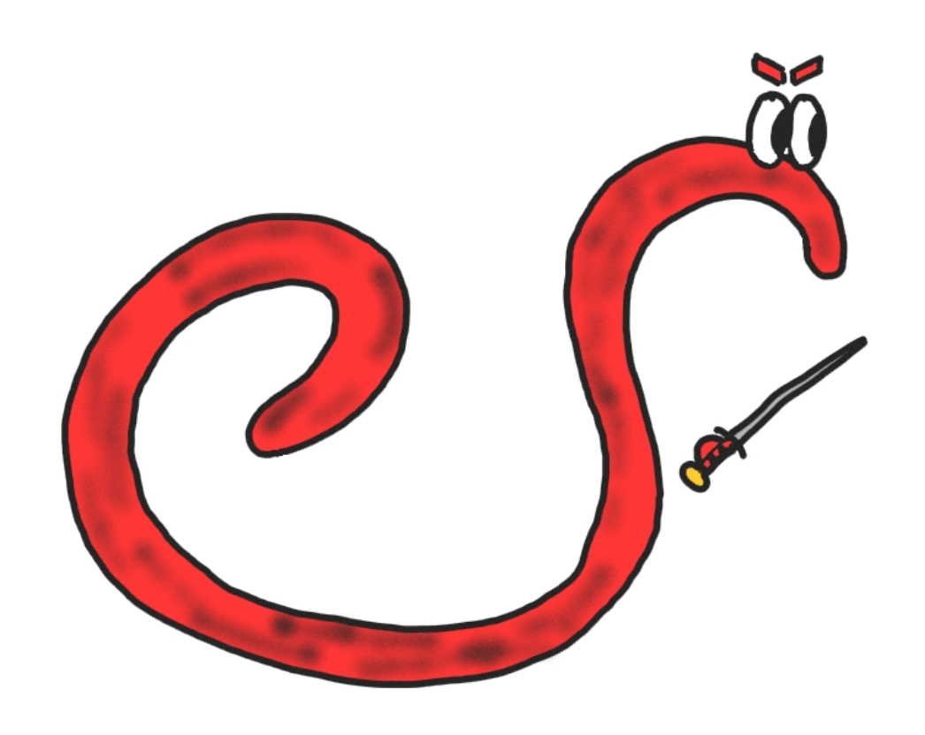
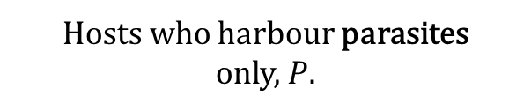
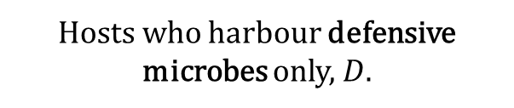
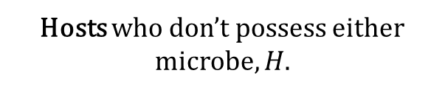
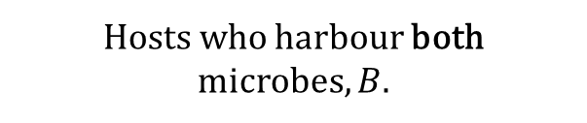
Defensive symbionts and parasites
Hosts who don’t possess either microbe, $H$.
Hosts, can be infected by one or both of…
Hosts who harbour defensive microbes only, $D$.
Defensive symbiont, able to invest resources to protect its host from…
Hosts who harbour parasites
only, $P$.
Parasite, very harmful to the host.
Hosts who harbour both
microbes, $B$.

Slide 31
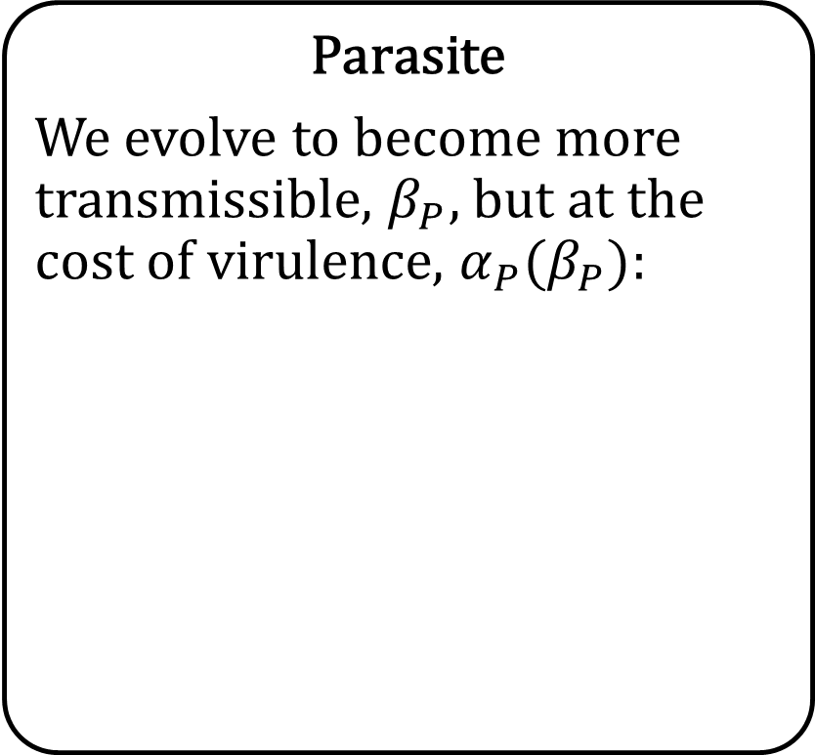
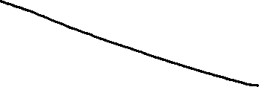
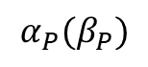
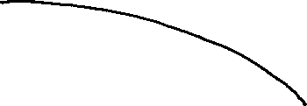
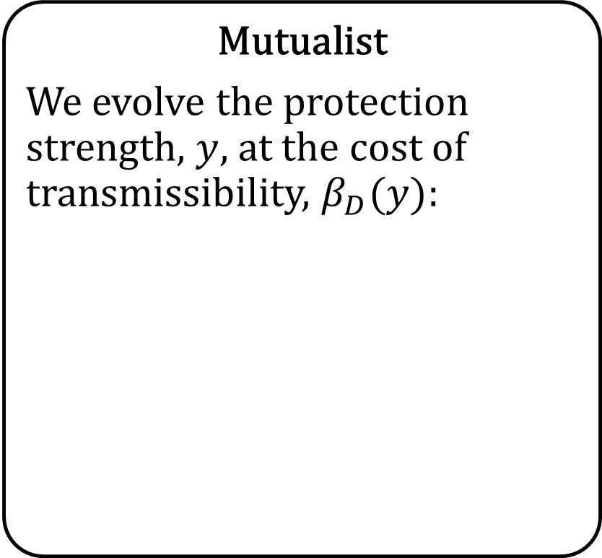
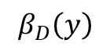
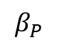
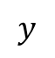
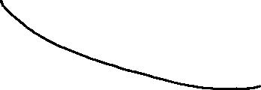
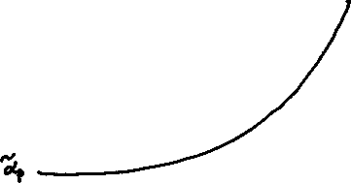
Trade-offs
Mutualist
We evolve the protection strength, $y$, at the cost of transmissibility, $β_{D}(y)$:
Parasite
We evolve to become more transmissible, $β_{P}$, but at the cost of virulence, $α_{P}(β_{P})$:
$$β_{D}\left(y\right)$$
$$α_{P}(β_{P})$$
$$y$$
$$β_{P}$$

Slide 32
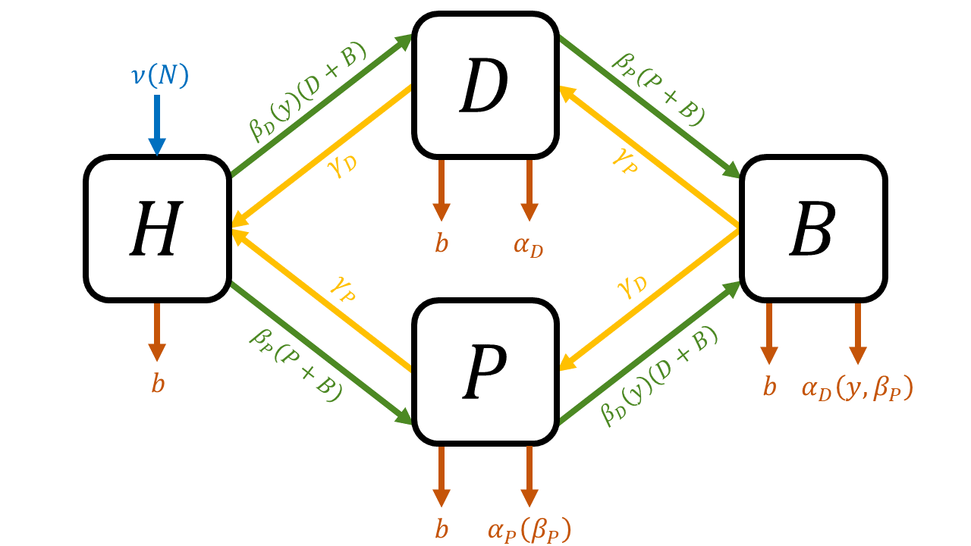


Ecological dynamics

Slide 33
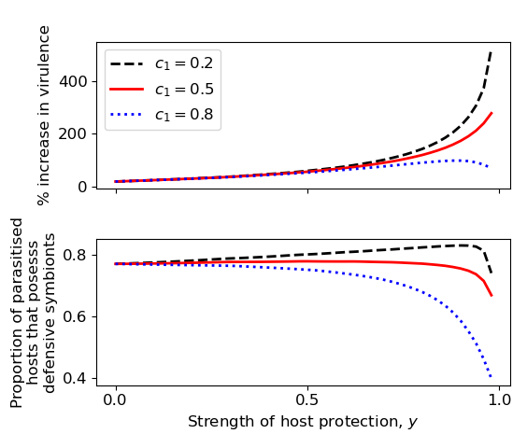
Defensive symbionts that confer tolerance always select for higher virulence

Slide 34
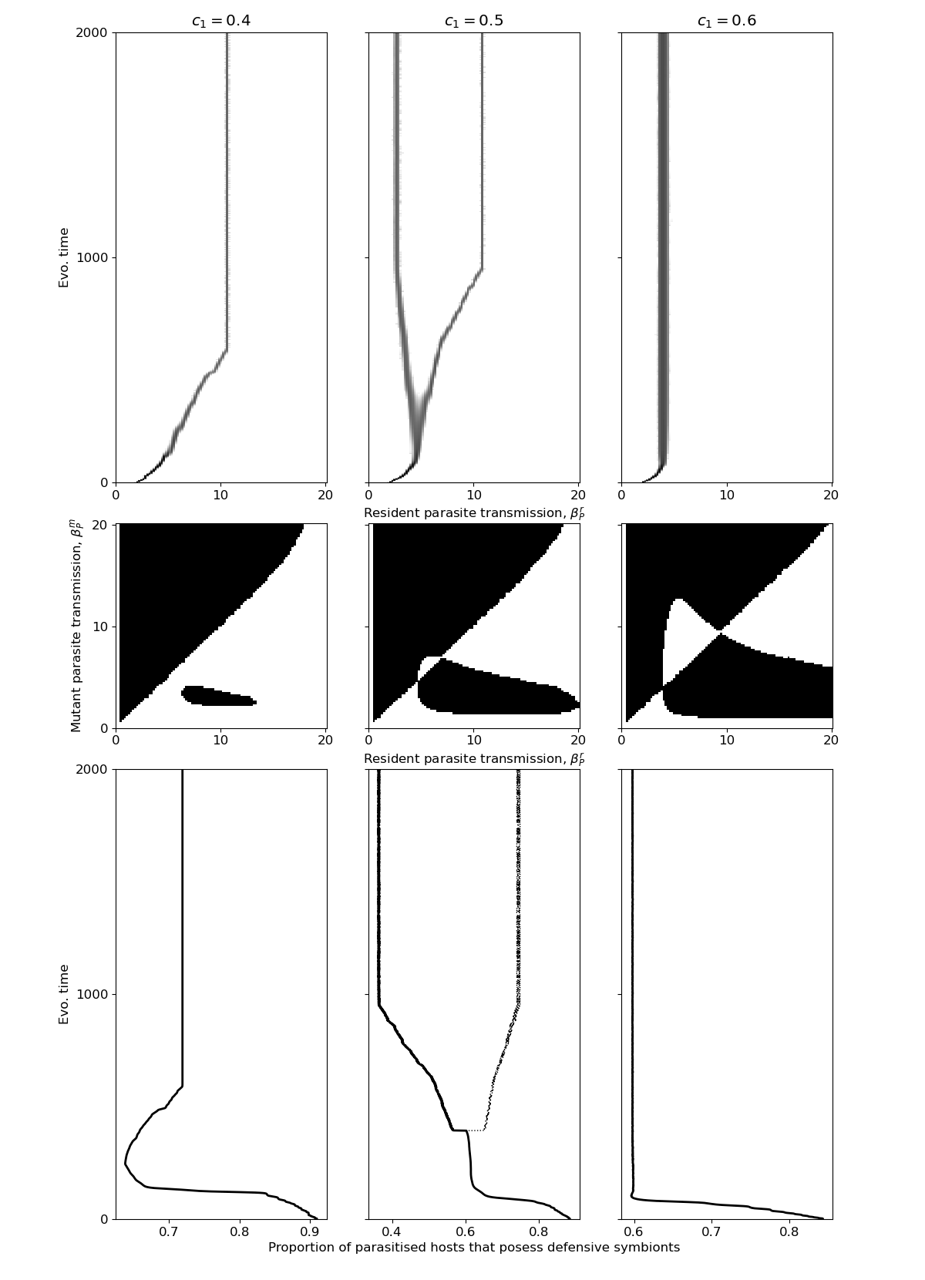
Defensive symbionts can drive parasite diversification

Slide 35
Defensive symbionts can drive parasite diversification

Slide 36
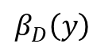
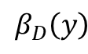


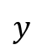
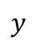
Symbiont-parasite coevolution can be detrimental to the host population – Part 1
Symbiont behaviour
$$β_{D}\left(y\right)$$
$$y$$
$$β_{D}\left(y\right)$$
$$y$$

Slide 37
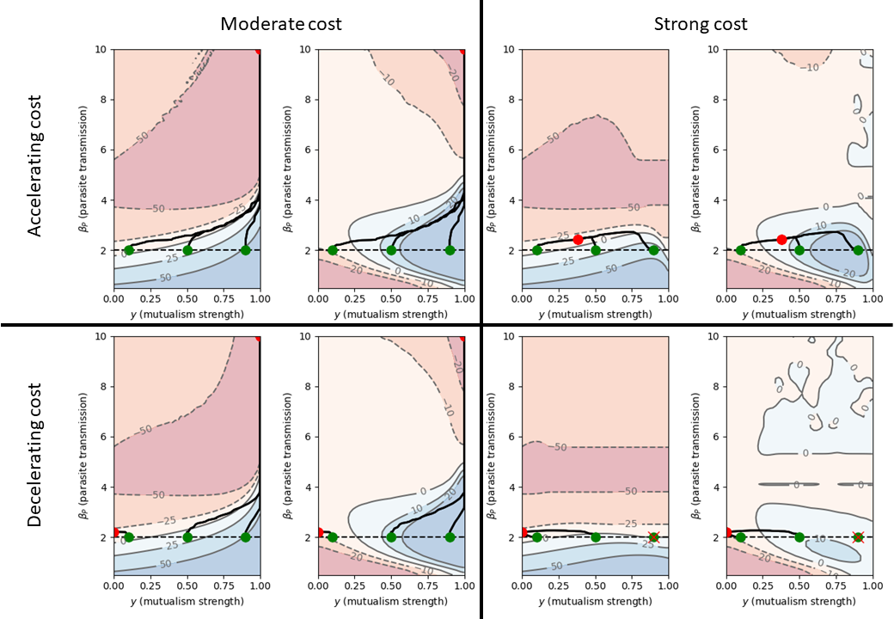
Symbiont-parasite coevolution can be detrimental to the host population – Part 2

Slide 38
Conclusions
To investigate the effects of symbiont-parasite coevolution on a host population
Coevolution of a defensive symbiont conferring tolerance to an already circulating parasite
Tolerance conferring defensive symbionts will almost certainly have a detrimental effect on the host population over many generations

Slide 39
Defensive Symbiont Coevolution

Slide 40
General premise
STI transmission is closely linked with mating dynamics
STIs have been shown to increase the mating rate, and attractiveness of hosts
There are, however, limitations to how much a mating rates can increase.
Here we investigate how parasites would coevolve with hosts under limiting trade-offs

Slide 41





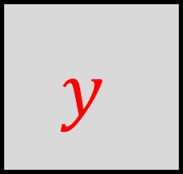
female
male
births
births
births
births / end of gestation
$$u$$
$$v$$
births
$$w$$
uninfected
fertilization
infected
infection
recovery
infection
recovery
infection
recovery
fertilization and infection
$$x$$
end of gestation
$$y$$
$$z$$
fertilization
mortality
mortality
mortality

Slide 42
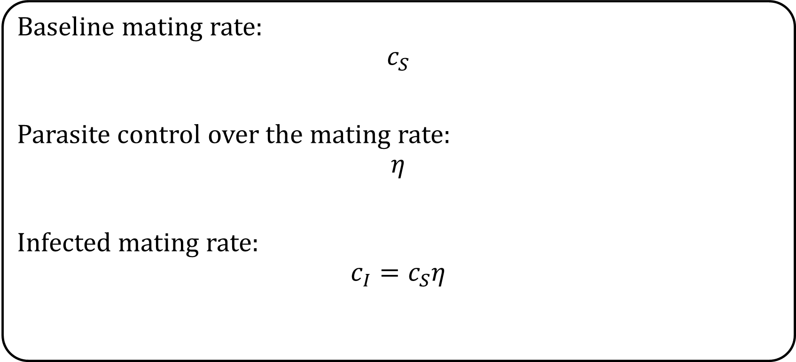
Assumptions
Baseline mating rate:
$$c_{S}$$
Parasite control over the mating rate:
$$η$$
Infected mating rate:
$$c_{I}=c_{S}η$$

Slide 43
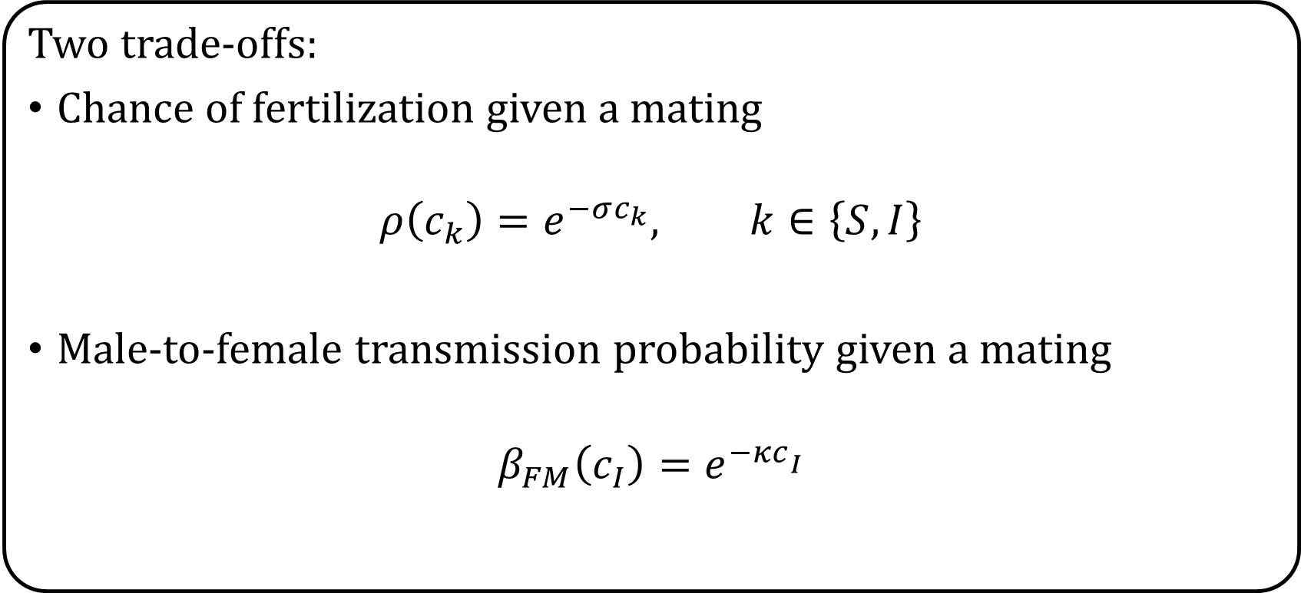
Assumptions
Two trade-offs:
Chance of fertilization given a mating
$$ρ\left(c_{k}\right)=e^{−σc_{k}}, k∈\left\{S,I\right\}$$
Male-to-female transmission probability given a mating
$$β_{FM}\left(c_{I}\right)=e^{−κc­_{I}}$$

Slide 44
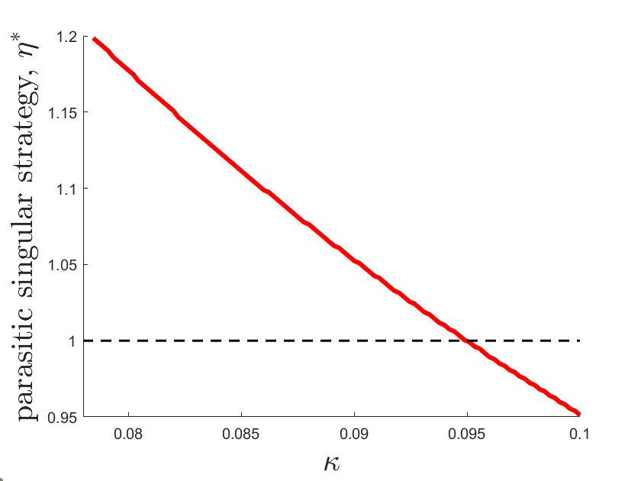
Parasite evolution

Slide 45
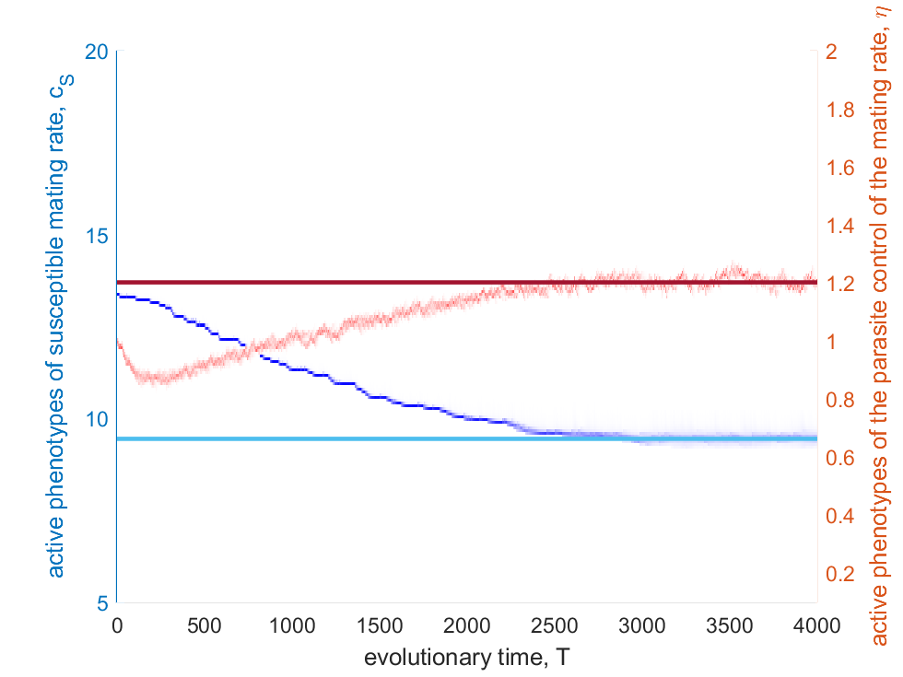
Coevolution

Slide 46
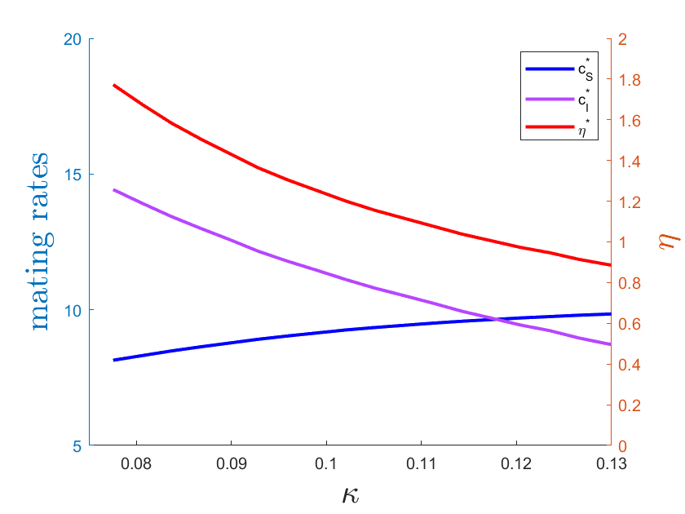
Coevolution

Slide 47

Parasite evolution

Slide 48

Parasite evolution

Slide 49

Coevolution

Slide 50
Conclusions
To investigate how sexually transmitted infections evolve and coevolve to manipulate host mating rates.
Coevolution of the baseline mating rate of hosts with parasitic control over mating rate, using trade-offs between mating rate and both the chance of fertilisation and transmission.
Under both parasite evolution and host-parasite coevolution we observe cases where the parasite will either increase or decrease the infected mating rate.

Slide 51




And finally…
Thank you for your attention.
Repository for presentation
Group website
Jason is supported by a scholarship from the EPSRC Centre for Doctoral Training in Statistical Applied Mathematics at Bath (SAMBa), under the project EP/L015684/1.
Cameron is funded by Natural Environment Research Council grant NE/V003909/1.
Alistair is supported by a University Research Scholarship Award from the University of Bath.

